Slide 1
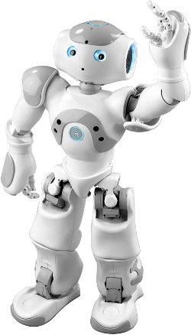
Nao by Nao
An introduction to robotics
Notes:
# initial standing pose
{behavior|StandHead}
\pau=3000\
# Slide 1.
{behavior|HelloEverybody}
Welcome everyone! \pau=500\ Good afternoon!
\pau=200\
{behavior|Intro}
{behavior|LegRandomMove}
My name is Robo Tutor. \pau=300\ Today I will be giving a lecture to you.
{behavior|HandOverLeft}
In this lecture I will present an introduction to robotics.
{behavior|MeAndYouLeft}
{behavior|LegRandomMove-500-0.8-500}
I will mostly be explaining to you about myself, \pau=300\and my fellow NAO robots.
{behavior|SpreadBoth}
The goal is to give you a general overview about how we work.

Slide 2
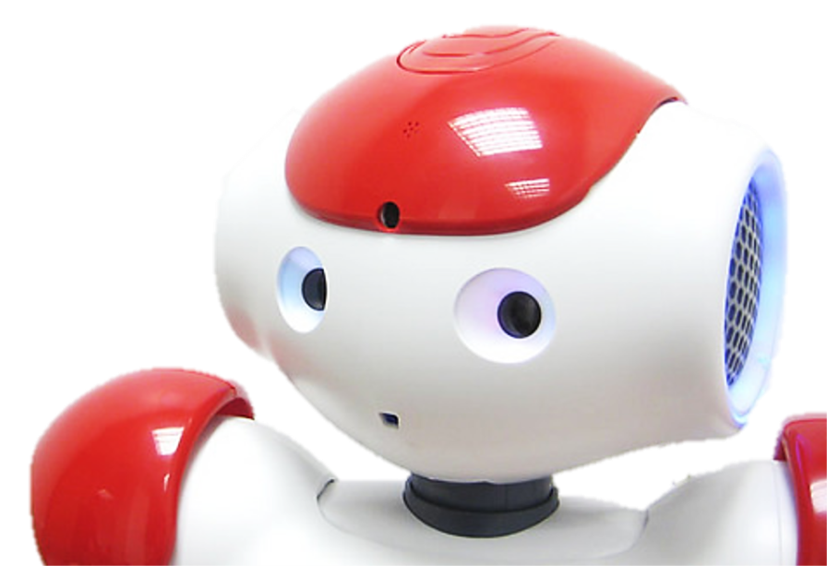
Overview
Introduction to Robotics
Sensors of NAO
Effectors of NAO
Programming a NAO
Applications – Robotutor
Notes:
# slide 2
{behavior|Twinkle}
{slide}
\pau=1000\
{behavior|FirstMe}
{behavior|LegRandomMove-500-0.8-500}
I will start with telling you a few basic things about robotics, and what kind of jobs we might be able to do for you.
{behavior|MeAndYouLeft}
{behavior|LegRandomMove-500-0.8-500}
Then I will use myself as an example to introduce common sensors, and effectors of a robot to you.
{behavior|PushAside}
I will also say a few things about, how you can write programs for controlling my behavior.
{behavior|HandOverLeft}
{behavior|LegRandomMove}
Finally, I will present an approach that, enables me to navigate in a hallway of the building that we are in.
{behavior|PressDown}
{behavior|LegRandomMove}
This is a common task for robots in general but quite a challenge for humanoids like me.
{behavior|PointForward}
Throughout this presentation, I will ask you some quiz questions. So please pay attention.
\pau=300\
{behavior|HandOver}
You should all have a turning point clicker.
\pau=300\
{behavior|LegRandomMove-500-0.8-500}
Please use this to answer the questions I present on the slides.

Slide 3
The word “robot” is derived from a Slavonic word which means serf.
True
False
9
Notes:
# Slide 3 Quiz-Trivial
{behavior|Twinkle}
{slide}\pau=1000\
{behavior|Balance}
{behavior|LegRandomMove}
Let us start with a trivial question. This is just to test the general background knowledge about robotics that you already may have.
{behavior|MeAndYou}
{behavior|LegRandomMove}
Using the clicker that we provided to you, please indicate whether you think
{behavior|SpreadLeft}
the following statement is true or false.
# speak the question
\pau=500\
{behavior|LegRandomMove}
The word robot is de-rived from a slavonic word, which means serf.
{behavior|PointForward}
I give you 10 seconds to answer this question, then we will discuss the answers.
# slide 3 - Start timer
{slide}
{behavior|LegRandomMove}
{behavior|LookAround}
# Wait for 10 seconds.
\pau=10000\
# slide 3 - Get results.
{slide}
\pau=2000\
# ??? Hackfix to trigger the turningpoint choice command.
{behavior|LegRandomMove}
Hum, let's see.
{turningpoint choice | You are correct! | That is incorrect. | Well, that is inconclusive! }
# slide 3 - Show correct answer.
{slide}
\pau=500\
# "is" should be emphasized
{behavior|Convince}
The word robot is de-rived from the slavonic word robotnik which means serf.
{behavior|First}
{behavior|LegRandomMove}
It was first used in a science fiction play in 1921.
{behavior|Think}
So the origin of the word robot is a little more than 90 years old.

Slide 4
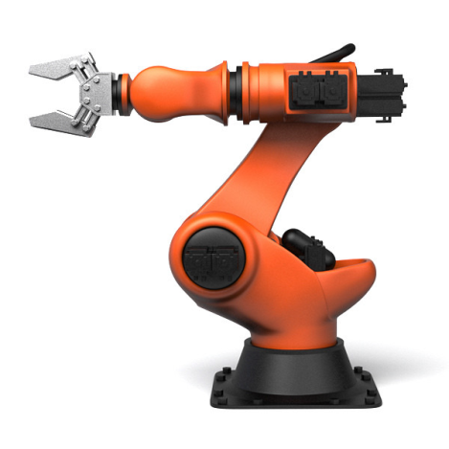
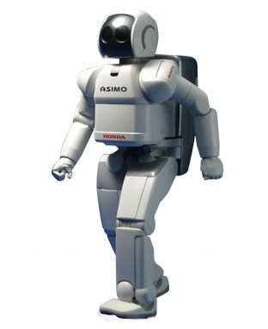
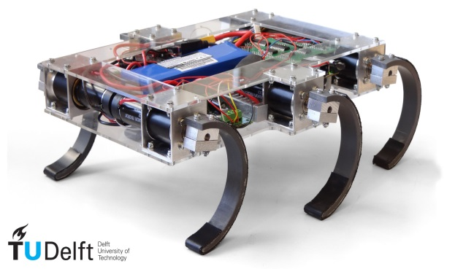
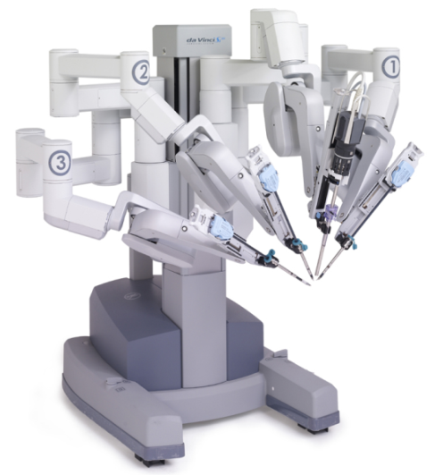
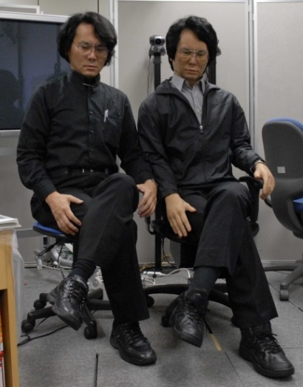
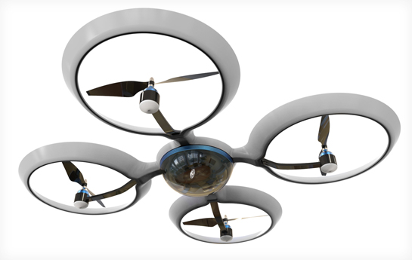
My (distant) robot family
KUKA
Asimo
Zebro
DaVinci
Quadcopter
Geminoid
Manipulators
Mobile Robots
Humanoids
Notes:
# Slide 4
{behavior|Twinkle}
{slide}\pau=1000\
{behavior|Me}
{behavior|LegRandomMove}
Let me introduce you to some of the more well-known members of my robot family.
{behavior|HandOverBoth}
I will show some more robot relatives of mine on the next slide.
\pau=500\
{behavior|Balance}
Manipulators are my most distant family members. They are physically anchored to their workplace.
{behavior|PointUpRight}
{behavior|LegRandomMove}
At the top left you see a typical assembly robot, the KUKA manipulator.
{behavior|FromAToB}
{behavior|LegRandomMove}
These robots are used to assemble many items, from cars to computers.
{behavior|No}
{behavior|State}
{behavior|LegRandomMove}
They do not have much intelligence, they just do as they are told in some sort of preprogrammed script.
\pau=500\
{behavior|HandOver}
{behavior|LegRandomMove}
On the left bottom, you see the doctor of the family, Da Vinci.
{behavior|ConvergeHands}
He works together with a human doctor or surgeon to perform many difficult surgeries.
{behavior|Capisce}
{behavior|LegRandomMove}
DaVinci is a high precision robot which makes surgeries a lot easier for doctors.
\pau=500\
{behavior|State}
Next to KUKA, you see the Ze-bro robot developed at Delft University.
{behavior|WavyShape}
{behavior|LegRandomMove}
Ze-bro is a member of the family of mobile robots and can move on rough terrain.
{behavior|Convince}
It is a very robust robot that can survive a fall of several meters.
\pau=500\
{behavior|PointFrontDown}
{behavior|LegRandomMove}
At the bottom, in the middle, you see a quadcopter that is a flying member of the mobile robot family.
{behavior|PushAsideBoth}
They are commonly used for surveillance.
\pau=500\
{behavior|ShowSideLeft}
To the right of Ze-bro you see Honda Asimo, my big brother.
{behavior|LegRandomMove}
Asimo is widely known for its abilities to walk up stairs, \pau=300\ jump,
{behavior|SpreadBoth}
and perform many jobs around the house.
{behavior|Balance}
He also appeared in the movie, Robot and Frank.
\pau=1000\
{behavior|SpreadLeft}
At the right bottom, you see a human sitting with a robot.
{behavior|Think}
{behavior|LegRandomMove}
Can you guess which is the robot?
\pau=1000\
They look quite similar, even indistinguishable if they do not move.
\pau=1000\
{behavior|State}
Robots like this are called Geminoid robots.
\pau=500\
{behavior|ConvergeHands}
These are just some of the many examples of robots in every day life.

Slide 5
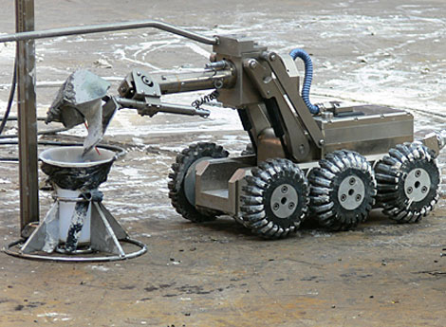
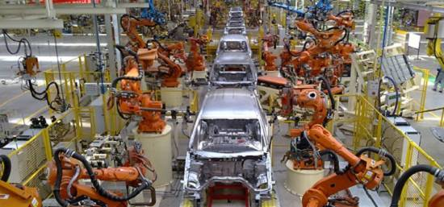
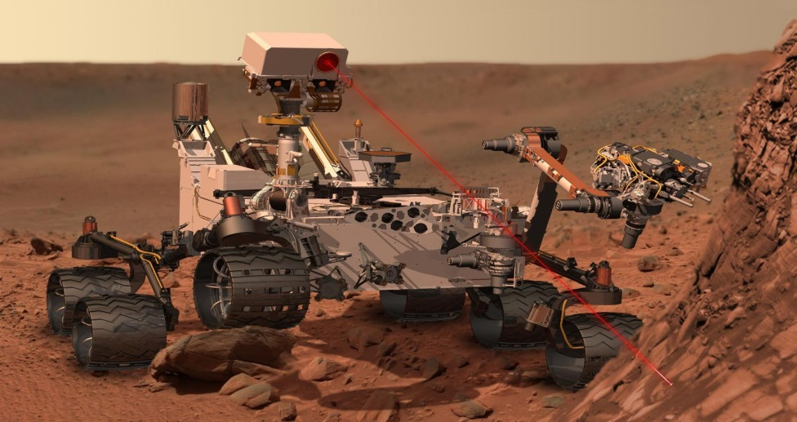
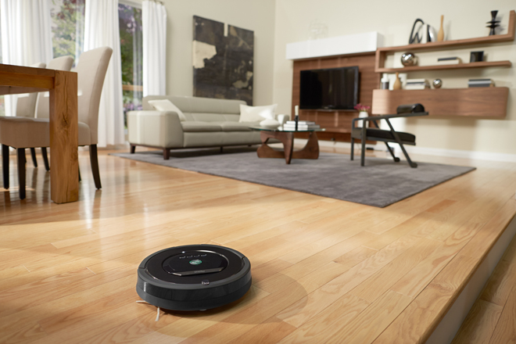
Why do you need us robots?
Tasks dangerous for humans
Repetitive, mechanical tasks
Exploration tasks
Service tasks
Notes:
# Slide 5
{behavior|Twinkle}
{slide}\pau=1000\
{behavior|RotatingCapisce}
{behavior|LegRandomMove}
So originally we are meant to serve you. But for what tasks can you put us to good use?
{behavior|Motivate}
I probably should make a good case here to convince you that I am worth the money.
{behavior|YouAndMe}
{behavior|LegRandomMove}
Unlike humans, we robots are not affected by fear, and we are able to help with dangerous tasks that you would rather not.
{behavior|Propose}
{behavior|LegRandomMove}
Take for example the nuclear disaster in Fukushima. Robots were used to clean up the nuclear waste.
{behavior|HandOver}
{behavior|LegRandomMove}
Unlike humans we robots also have no problem performing repetitive tasks like boxing items
{behavior|ConvergeHands}
and putting things together.
{behavior|LegRandomMove}
For example, all cars produced today are assembled by robots.
{behavior|PushAsideBoth}
In many assembly line tasks, we robots have become more cost-effective than human workers.
{behavior|PushAsideBoth}
{behavior|LegRandomMove-500-0.8-500}
We are also becoming very effective tools for gathering information in domains that are difficult (or dangerous) for people to access.
{behavior|No}
Without robots you would not have explored Mars!
# more and more
And last but not least we are also
{behavior|PushAsideBoth}
becoming more and more able to assist individuals in performing daily tasks.
{behavior|SpreadLeft}
For example, you can buy my relative called the Roomba to vacuum clean your house.
{behavior|Applaud}
It can even detect filthy areas that need more cleaning.

Slide 6
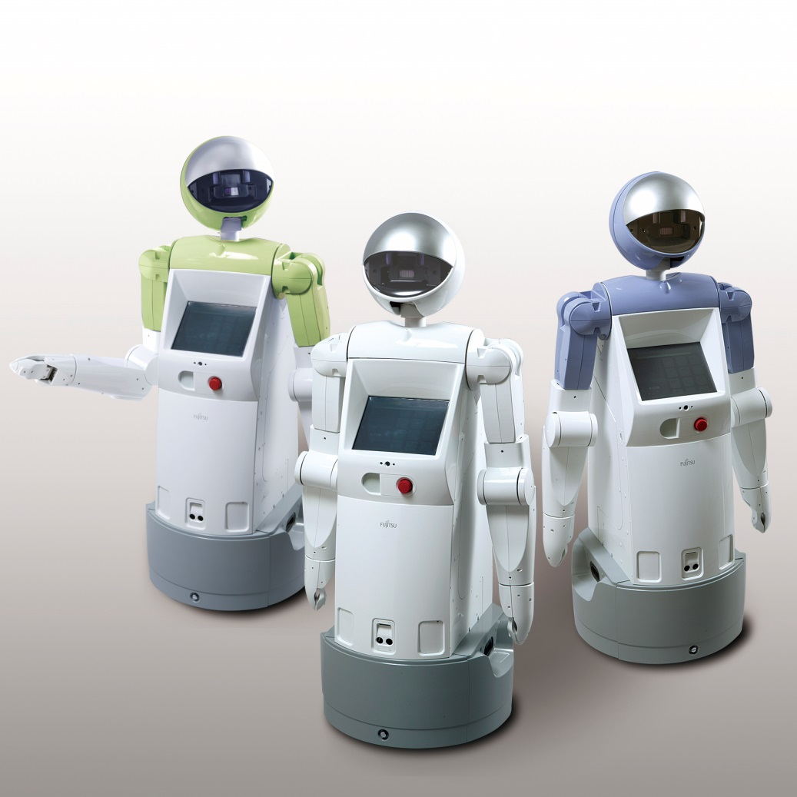
What is a robot?
A robot is:
Physical Agent
Manipulates the physical world
Has sensors
Has effectors
Notes:
# slide 6
{behavior|Twinkle}
{slide}\pau=1000\
{behavior|ConvergeHands}
{behavior|LegRandomMove}
Let's now try to define what a robot is.
\pau=1000\
{behavior|Me}
As you will have noticed I am a robot. Because I have \rmw=1\legs, arms\rmw=0\
{behavior|ShowBody}
and a body that looks a bit like a human, \pau=500\I am a humanoid robot.
Although we most of the time,
{behavior|SpreadBoth}
{behavior|LegRandomMove}
all will agree on seeing a robot when we see one, providing a definition that we all agree on,
{behavior|No}
is not so easy.
\pau=1000\
{behavior|Capisce}
{behavior|LegRandomMove}
Russell and Norvig define robots as, "physical agents that perform tasks by manipulating the physical world."
{behavior|LegRandomMove}
To this end, robots are equipped with effectors and sensors.
{behavior|SpreadBoth}
{behavior|LegRandomMove-500-1.2-800}
One of the issues with a typical definition as this one, is that, some appliances that you might think, are not robots, technically are.
{behavior|Think}
{behavior|LegRandomMove-500-1.2-800}
Imagine, for example, your home thermostat. It is a physical agent, also has sensors and effectors, and manipulates temperature in the physical world.
{behavior|PressDown}
But a thermostat clearly is something very different from a robot like me!
\pau=200\
{behavior|PushAsideBoth}
{behavior|LegRandomMove}
Up to now, there is no standard definition of robot that satisfies everyone, and many people have their own.

Slide 7
Which of these, according to the definition, is not a robot?
Zebro
A classic vacuum cleaner
Cruise control
The Mars rover
9
Notes:
# Slide 7
{behavior|Twinkle}
{slide}\pau=1000\
{behavior|Balance}
Let's see if you understood the definition of robot.
{behavior|State}
\pau=500\
Which of the following is, according to the previously given definition, not a robot?
\pau=500\
{behavior|LegRandomMove}
You have 10 seconds to answer this question, then we will discuss the answers.
{behavior|LookAround}
# Slide 7 - Start timer
{slide}
{behavior|LegRandomMove}
# Wait for 10 seconds.
\pau=10000\
# Slide 7 - Get results.
{slide}
\pau=2000\
# Hackfix to trigger the turningpoint choice command.
# last is a tie
{behavior|LegRandomMove}
Hum, let's see.
{turningpoint choice | I told you Ze-bro is a robot. | That is correct. | You might think so, but a cruise control also has sensors and effectors that work in real time. | You can tele operate the mars rover, but it can also work autonomously | Well, it seems I have not been clear enough before. }
# Slide 7 - Show correct answer.
{slide}
\pau=500\
{behavior|HandOver}
{behavior|LegRandomMove}
The correct answer was the vacuum cleaner.
{behavior|Weigh}
It does have effectors, but it does not have any sensors.

Slide 8
How do we work?
Sensor
Control Program
Effector
Notes:
# Slide 8
{behavior|Twinkle}
{slide}\pau=1000\
{behavior|FirstMe}
From now on, I will take myself as a leading example to explain to you in more detail
{behavior|OneTheOther}
about robot sensors and effectors.
{behavior|LegRandomMove}
I will also tell you something about creating a program to control me.
\pau=300\
{behavior|HandOverBoth}
I will give you an overview of the most common, and important aspects.

Slide 9
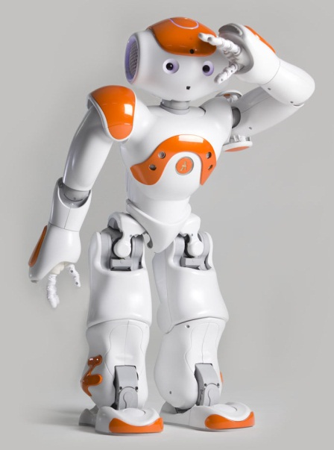
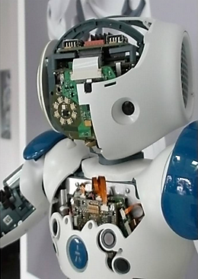
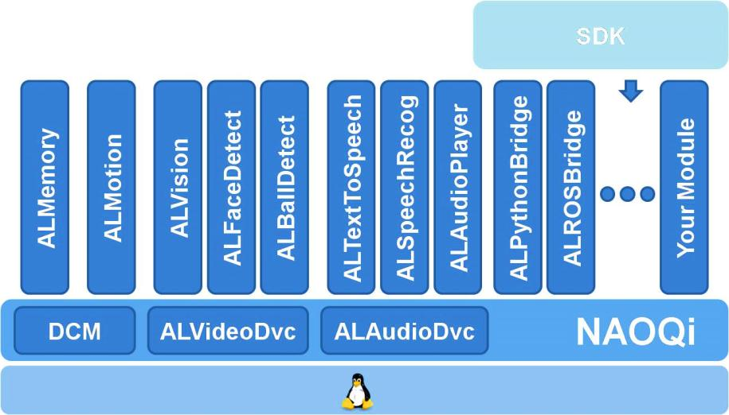
Humanoid Robot NAO
Humanlike appearance
Programmable, compact, electro-mechanical
Processor: Intel Atom Z530
Software
Linux System
Control Architecture: NaoQi Framework
(AL)Modules and self-built modules
Multi-language SDK
Notes:
# slide 9
{behavior|Twinkle}
{slide}\pau=1000\
{behavior|YouAndMe}
When you see a humanoid robot like me, you must be attracted by my elegant appearance.
{behavior|SmallBow}
{behavior|LegRandomMove-500-1.2-800}
But in fact, I am a programmable compact electromechanical system, equipped with sensors that capture states of my body and the world around me.
\pau=400\
{behavior|ConvergeHands}
{behavior|LegRandomMove}
All information gathered by my sensors is then processed
{behavior|MeLeft}
by my processors to decide what to do next.
{behavior|Capisce}
Based on this decision, I then use my effectors to manipulate objects or just move my limbs.
{behavior|RotatingCapisce}
{behavior|LegRandomMove}
To this end, a Linux system was tailored for me, to manage the data from various sensors, and schedule the control of effectors.
{behavior|LegRandomMove}
A framework called Nao Qi, which is a modular architecture, was designed to enable developers to build customized modules.
{behavior|Me}
One can also control me using SDK libraries. I will provide details later on.

Slide 10
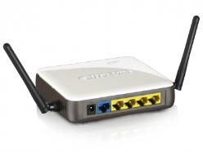
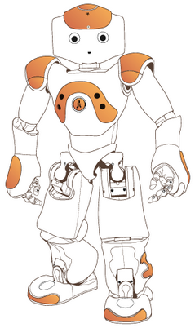

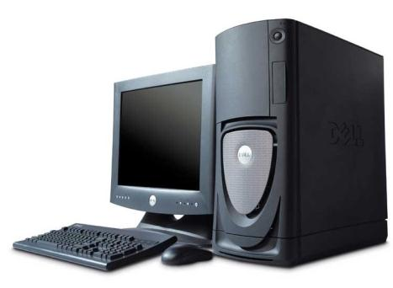
Remote and Local Control
Server
Client
Local vs. Remote
Trade-off
Computational power
Data transmission cost
Core i7 on the
desktop/laptop
Atom Z530
on the robot
Notes:
# slide 10
{behavior|Twinkle}
{slide}\pau=1000\
{behavior|HandOverLeft}
{behavior|LegRandomMove}
There are two main methods for controlling me.
{behavior|State}
One approach is to add a module on my Linux system, which then can be executed after I boot up.
{behavior|RotatingCapisce}
{behavior|LegRandomMove}
The other approach is probably more convenient for developers. That is to control me from a remote computer through Wi Fi or cables.
{behavior|You}
As you may know, a typical desktop or laptop computer
{behavior|Weigh}
{behavior|LegRandomMove}
has more computation power, than I have on board. Therefore, the execution of a complex algorithm
{behavior|Propose}
{behavior|LegRandomMove-500-0.8-500}
may take significantly more time on me, than on a separate computer. However, you also need to consider that transmitting data
{behavior|FromAToB}
from me to a computer also costs time.
{behavior|LegRandomMove-500-0.8-500}
For example, images may cost hundreds of milliseconds before they are transferred to the computer.
{behavior|LegRandomMove}
Thus, you will always need to make
{behavior|Weigh}
a trade off between running a module on me, or on a computer.

Slide 11
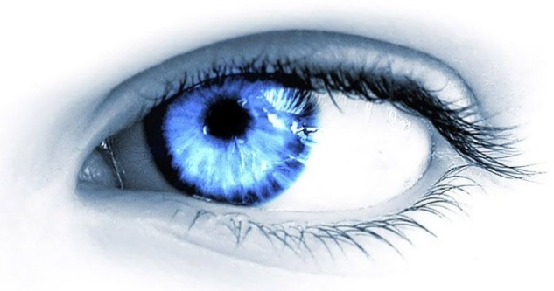
Sensors
Sensors
Perceive properties and events from environment
Color, shape, size of objects
A human is approaching the robot
Feedback on its own behaviors
Is the robot hand touching the cup?
Example sensors:
Gyroscope, thermometer,
laser sensor, camera, microphone,
etc.
infrared
camera
lasers
GPS
digital
compass
photoelectric
encoder
sonar
Notes:
# slide 11
{behavior|Twinkle}
{slide}\pau=1000\
# all
{behavior|PushAsideBoth}
All robots need some type of sensors to observe the world around them.
\pau=200\
{behavior|OneTheOther}
Some robots need more sensors than others.
\pau=200\
{behavior|LegRandomMove}
For example, the assembly robot of several slides ago, barely needs any sensors at all.
{behavior|SpreadLeft}
Humans however, already have more than 700 sensors.
{behavior|Tiny}
in one square inch of skin.
\pau=500\
{behavior|PressDown}
{behavior|LegRandomMove}
It also depends on the task. A robotic vehicle that has to navigate in a complex environment needs many sensors, as you can see on the right of the slide.

Slide 12
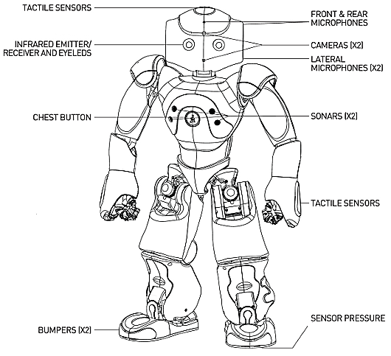
Sensors of NAO
Camera 2
Microphone 4
Sonar 2
Pressure 8
Tactile 9
Bumper 4
Button 1
Infrared 2
Accelerometer 1
Gyro 2
Joint Position Sensor 36
Current/Temperature Resistors 27
Notes:
# slide 12
{behavior|Twinkle}
{slide}\pau=1000\
{behavior|LegRandomMove}
{behavior|YouAndMe}
On the slide you can see what kind of sensors I have myself. I have 98 sensors in total.
{behavior|LegRandomMove}
Most of these sensors I need to function properly.
{behavior|No}
{behavior|LegRandomMove}
Do not look down upon the tiny resistors. For example, I have 27 tiny resistors that I use for detecting,
{behavior|OneTheOther}
both the current to the motors, and the battery. These current values
{behavior|LegRandomMove}
{behavior|Capisce}
are also used to, estimate the temperature of my joints and battery.
{behavior|You}
{behavior|LegRandomMove}
Now, I will introduce the more complex ones, in more details to you.

Slide 13
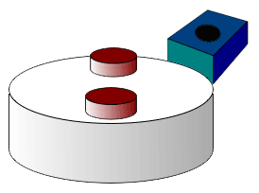
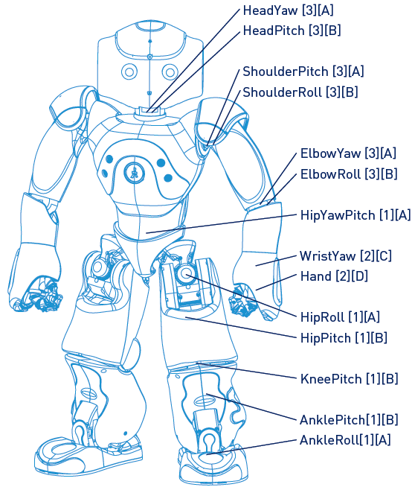
Sensor – Position sensors (Magnetic Rotary Encoder)
Detect the (angular) position of joints/motors
In the picture
Two equally spaced magnets
The output voltage peaks twice per revolution.
Notes:
# slide 13
{behavior|Twinkle}
{slide}\pau=1000\
# joints position sensor
{behavior|ShowBiceps}
The position sensors are the most frequently used sensors inside my body.
{behavior|RotatingCapisce}
They are used to detect the angles of the joint rotation.
{behavior|LegRandomMove}
The sensor detects the angular position of the permanent magnet.
{behavior|PointUpRight}
{behavior|LegRandomMove}
The top right picture illustrates a wheel, with two equally spaced magnets. The voltage from the sensor, will peak twice for each revolution.

Slide 14
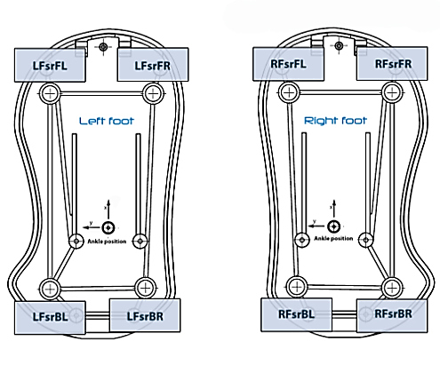
Force sensor - Force Sensitive Resistors
Detect whether the robot is standing on something
Force change -> Resistor value change
Walking balance
Fall-down detection
Notes:
# slide 14 pressure sensor
{behavior|Twinkle}
{slide}\pau=1000\
{behavior|LegRandomMove}
{behavior|State}
The force sensor utilizes a material, whose resistance changes, when a force or pressure is applied. I need them to check
{behavior|PushAside}
whether my feet are positioned correctly. They can be used to determine
{behavior|Balance}
whether I am balanced when I move my legs, and whether I am falling down. This information is also used
{behavior|Walk}
{behavior|SpreadLeft}
during the walk. At least one foot must maintain contact with the ground, otherwise I will stop walking.

Slide 15
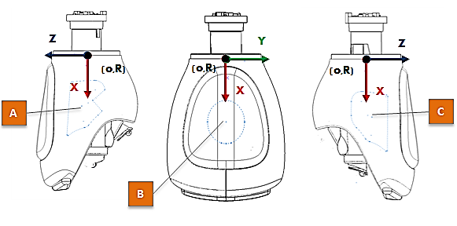
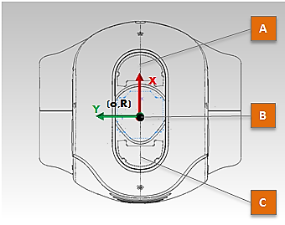
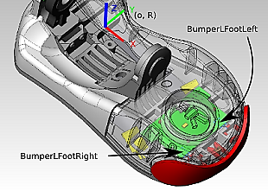
Tactile Sensors
Hand (3)
Left, Right, Back
Head (3)
Front, middle, back
Foot (2x2)
Left, right
Notes:
# slide 15 tactile
{behavior|Twinkle}
{slide}\pau=1000\
# tactile
{behavior|ShowMicLeft}
{behavior|LegRandomMove}
There are tactile sensors on my head and hands, to detect if someone is touching me.
The bumpers on the front of my feet act as collision sensors, to check if I bumped into something.
{behavior|tactileinteraction}
Hi, Koen. Could you check whether the tactile sensors on my head are working?
\pau=10000\
The sensors are working well! He just hurt my head!

Slide 16
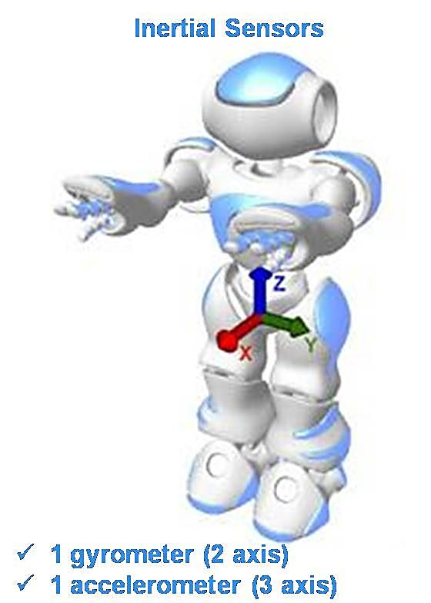
Inertial and Gyro sensors
Acceleration: x, y, z
Rotation: Roll (x), Pitch (y)
Tracking the robot position
Tracking the robot pose
Walking balance
Fall-down detection
Notes:
# slide 16
{behavior|Twinkle}
{slide}\pau=1000\
# inertial and gyro sensors
{behavior|Me}
{behavior|LegRandomMove-500-1.0-500}
I have inertial sensors that can track my position in real time based on the detected acceleration of my body.
{behavior|LegRandomMove-500-0.8-500}
The gyro sensors provide me information about my orientation.
{behavior|State}
Thus, I can determine my next step using this information.
{behavior|LegRandomMove}
Since these sensors are sensitive to acceleration, they are also used to detect whether I am falling down.

Slide 17
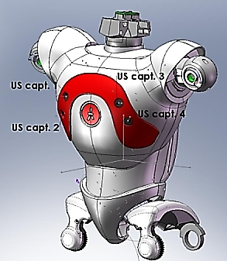




Sensor - Sonar
Emitter-receiver pairs ×2 on front
Resolution: 1cm
Effective cone: 60°
Detection Range: 0.25m to 2.55m
Obstacle detection
Pros: Fast
SonarLeft
Detected
SonarRight
Detected
SonarLeft
NothingDetected
SonarRight
NothingDetected
Events:
Notes:
# slide 17 sonar
{behavior|Twinkle}
{slide}\pau=1000\
# sonar
{behavior|ShowChest}
{behavior|YouAndMe}
{behavior|LegRandomMove-500-0.8-500}
On my chest, I have two sets of sonar sensors to approximate the distance between me and objects in front of me, and to roughly estimate the position of the objects,
{behavior|LegRandomMove-500-0.6-500}
as you can see in the pictures on the bottom of the slide.
{behavior|HandOver}
The sensor contains an emitter which sends out the ultrasonic wave, and a receiver
{behavior|Me}
which receives the ultrasonic wave rebound from obstacles.

Slide 18
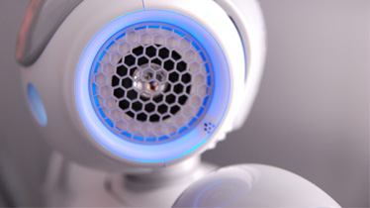
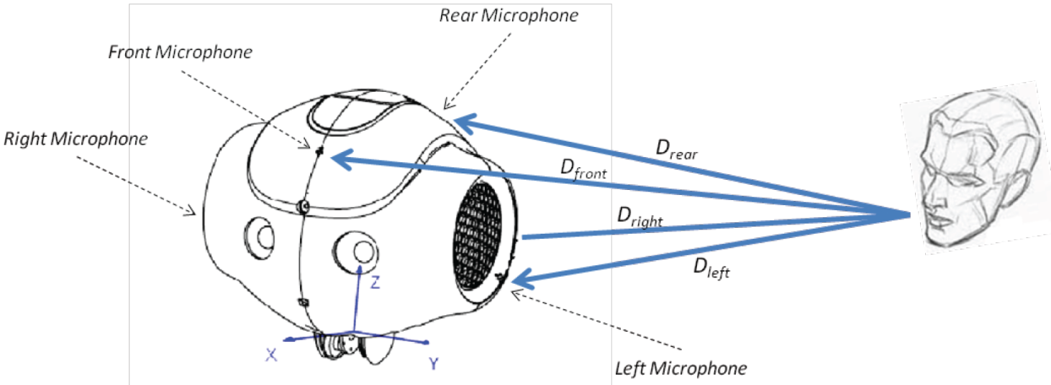
Sensor - Microphone
4: front, rear, left, right
Speech recognition
Match predefined words
Cannot recognize undefined words
Audio source localization
Notes:
# slide 18 microphone
{behavior|Twinkle}
{slide}\pau=1000\
{behavior|LegRandomMove}
Like how you use your ears to listen,
{behavior|ShowMic}
I have 4 microphones located on my head to do the same. I can localize the sound source,
{behavior|OneTheOther}
{behavior|LegRandomMove}
and determine whether the words I hear match the words I expect.
{behavior|HandOver}
As you can see the in the picture at the bottom,
{behavior|RotatingCapisce}
{behavior|LegRandomMove}
{behavior|LegRandomMove-800-0.5-0}
the different distances that the sound waves need to travel, induce time differences of arrival, which are measured and used to compute the current position of the source.

Slide 19
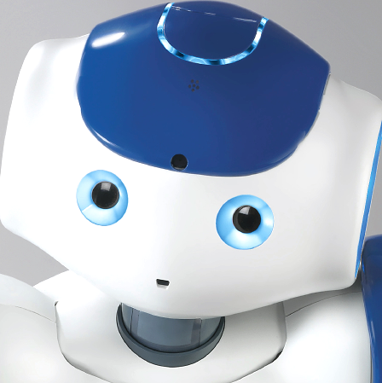
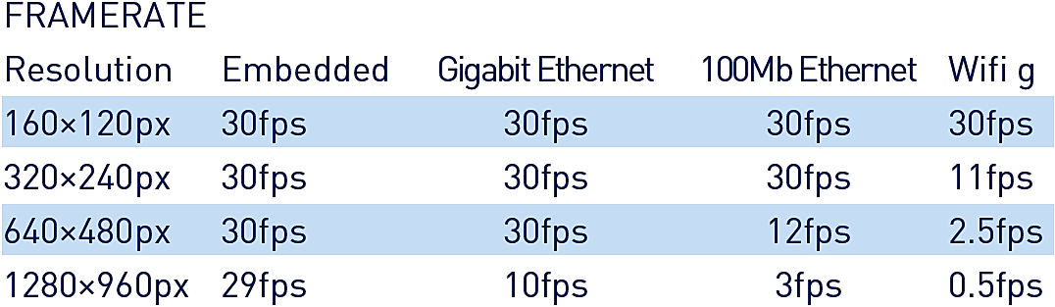
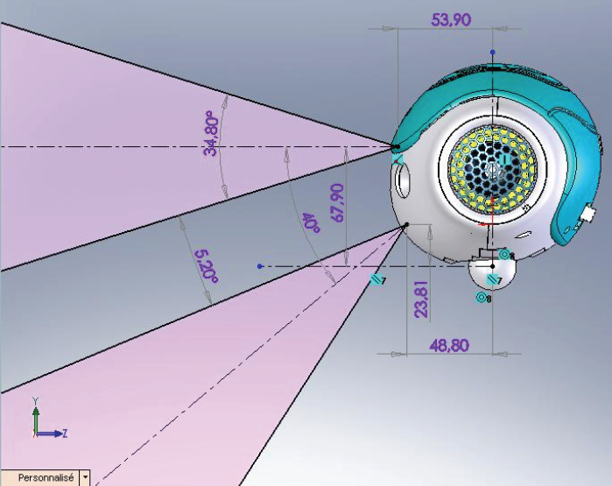
Sensor - Camera
Number×2 on front
Active Pixels 1288×968
Frame Rate
Non-overlapped field of View
Focus Range: 30cm ~ infinity
Notes:
# slide 19 camera
{behavior|Twinkle}
{slide}\pau=1000\
# camera
{behavior|YouAndMe}
Similarly to how you use your eyes to see, I use two cameras which I can use to see you.
Although the resolution of
{behavior|MeAndYou}
{behavior|LegRandomMove}
my eyes is much less than your eyes, I can still recognize many things with the help of computer vision algorithms.
However, the field of view of my cameras
{behavior|No}
{behavior|LegRandomMove}
does not overlap, so 3D vision algorithms cannot be applied to me directly.
{behavior|State}
Fortunately, my developers have invented a method for stereo vision, by using two images
{behavior|LookAround}
taken at different perspectives by one of my cameras.
\pau=1000\
# photo
{behavior|First}
{behavior|LegRandomMove}
Now, I will take a photo of you, using the camera on my forehead, and put it on the slide, to show, how my camera works.
# head pose for taking a photo
{behavior|PhotoHeadPose}
It takes some time, to create the slide.
\pau=1000\
# Take a photo
{show image}
\pau=5000\
# head pose back
{behavior|StandHead}
Almost done.
{slide}
\pau=1000\
{behavior|You}
{behavior|LegRandomMove}
You there, on the front, \pau=300\ you weren't sleeping, were you?
\pau=2000\

Slide 20
Traditional stereo vision cannot be constructed directly using the cameras on the NAO because
They are not located horizontally
They have no overlapped field of view
Computational power is insufficient on the robot
Software for stereo-vision is not available for the NAO
9
Notes:
# Slide 20 Quiz Stereo Vision
{behavior|Twinkle}
{slide}\pau=1000\
{behavior|SpreadBoth}
As I said, I do not have stereo vision. Do you know why?
{behavior|LegRandomMove}
# 5 seconds for student to read
\pau=5000\
Also ten seconds for answering the question!
{behavior|LookAround}
{behavior|LegRandomMove}
# Start timer
{slide}
# Wait for 10 seconds.
\pau=10000\
# Get results.
{slide}
\pau=2000\
# Hackfix to trigger the turningpoint choice command.
{behavior|LegRandomMove}
Hum, let's have a look.
{turningpoint choice | You might think so, but it does not matter. | Good. | Computational power may be insufficient, but it is OK to use a remote computer. | The major library of computer vision is written in C plus plus and is definitely available for me. | Well, it seems that your opinions are divided. }
# Show correct answer.
{slide}
\pau=500\
The correct answer was B.
{behavior|Propose}
The overlapped field of view is necessary for stereo vision.

Slide 21
How many sensors do you think I have?
20 – 40
40 – 60
60 – 80
80 – 100
9
Notes:
# Slide 21
{behavior|Twinkle}
{slide}\pau=1000\
I have another question.
\pau=500\
{behavior|HandOver}
I have just explained to you what kind of sensors I have.
{behavior|SpreadBoth}
{behavior|LegRandomMove}
But do you remember how many sensors I have in total?
\pau=500\
Think for 10 seconds and give me an answer.
{behavior|LookAround}
{behavior|LegRandomMove}
# Start timer
{slide}
# Wait for 10 seconds.
\pau=10000\
# Get results.
{slide}
\pau=2000\
# Hackfix to trigger the turningpoint choice command.
{behavior|LegRandomMove}
Hum, let's see.
{turningpoint choice | You might think so, but it's a lot more than that. | Getting close, but it's a little bit more than that. | Getting close, but it's somewhat more than that. | Great. | Well, it seems that your opinions are divided. }
# Show correct answer.
{slide}
\pau=500\
{behavior|ShowBody}
The correct answer was D, I have 98 sensors in total.
{behavior|PushAside}
{behavior|LegRandomMove}
I have 27 resistors for measuing the current,
{behavior|PushAsideLeft}
36 joint position sensors,
{behavior|LegRandomMove}
{behavior|OneTheOther}
8 pressure sensors, and 9 tactile sensors. The sum of them is 80 already.

Slide 22
Which module is the most suitable to run on the robot?
Sonar based obstacle avoidance
3D reconstruction of environment based on computer vision
Speech-to-text recognition
Facial expression recognition
15
Notes:
# slide 22 Quiz running on the robot
{behavior|Twinkle}
{slide}\pau=1000\
# question
One more question.
{behavior|Me}
According to the information about the sensors I just provided you.
{behavior|LegRandomMove}
which function is more suitable to be placed on the robot than others?
\pau=1000\
{behavior|Propose}
{behavior|LegRandomMove}
This is a difficult one. Think before you give me an answer. You have fifteen seconds.
{behavior|LookAround}
{behavior|LegRandomMove}
# Start timer
{slide}
# Wait for 15 seconds.
\pau=15000\
# Get results.
{slide}
\pau=2000\
# Hackfix to trigger the turningpoint choice command.
{behavior|LegRandomMove}
Hum, let's see.
{behavior|LegRandomMove}
{turningpoint choice | You are right. | 3D reconstruction and computer vision algorithms are computationally expensive, and thus not suitable to run on the robot. | Speech to text recognition is not the same as matching words, which I just explained to you. | Computer vision algorithms such as facial expression recognition is computationally expensive, and thus not suitable to run on the robot. | Well, it seems that you did not achieve an agreement. }
# Show correct answer.
{slide}
\pau=500\
The correct answer was A.
{behavior|ConvergeHands}
{behavior|LegRandomMove}
It does not need much computational power to determine, whether obstacles exist in front of me,
{behavior|LegRandomMove}
according to the distance, detected by the sonar sensors.

Slide 23
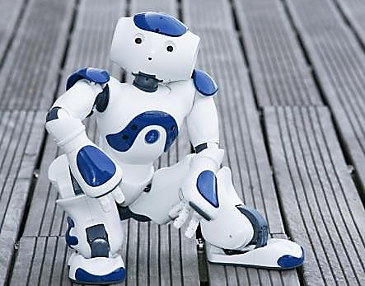
Break
Notes:
# BREAK BREAK BREAK
{behavior|Twinkle}
{slide}
\pau=1000\
{behavior|LegRandomMove}
{behavior|Me}
I have talked for quite a while, let's have a break.
{behavior|LegRandomMove}
{behavior|LookAround}
Please fill in the questionnaire handed to you.
{behavior|LegRandomMove}
The lecture will continue in 5 minutes.

